Slide 1
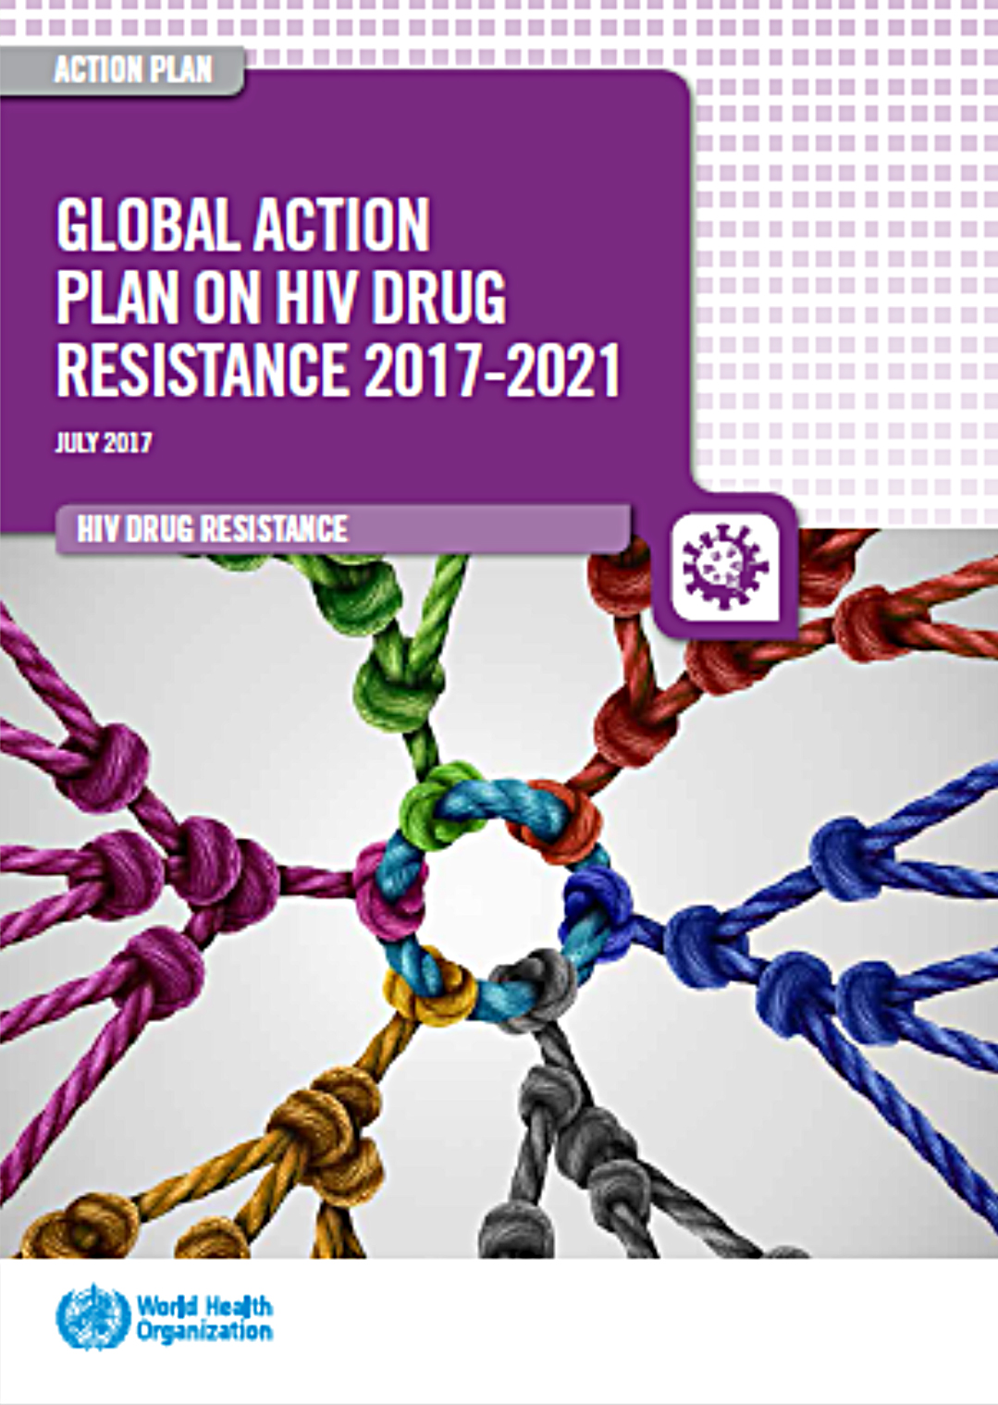
Global Action Plan on HIVDR 2018 Progress Report
Notes:
In 2017, WHO jointly with partners developed the global action plan to address the rising levels of drug resistance. This year, we assessed the progress in implementation and areas where additional focus is needed

Slide 2
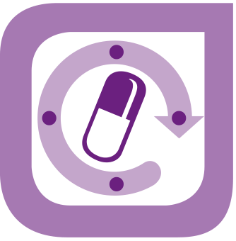
Global Action Plan on HIV Drug Resistance (HIVDR)
Summary of progress (2018)
↓ Suboptimal progress in HIVDR prevention
↓ Slow response to high levels of pretreatment HIVDR
Prevention & Response
Monitoring & Surveillance
Research & Innovation
Laboratory Capacity
Governance & Enabling Mechanisms
↑ Increased uptake of HIVDR surveys
↓ Need for better monitoring of program quality
↑ Positive progress in addressing research gaps on HIVDR
↓Suboptimal viral load testing coverage
↑ Improved capacity for DR testing for surveillance
↑ Increased country ownership
↑ Increased support by donors
↑ Initial involvements of community groups

